Slide 1
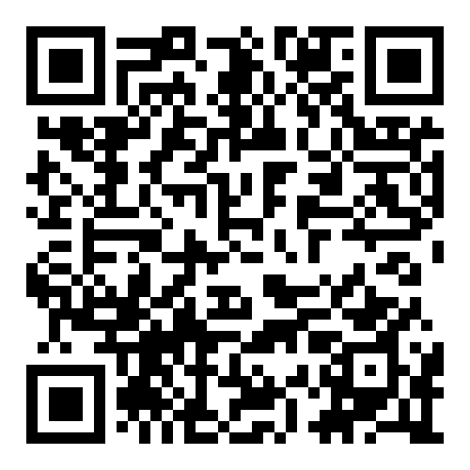
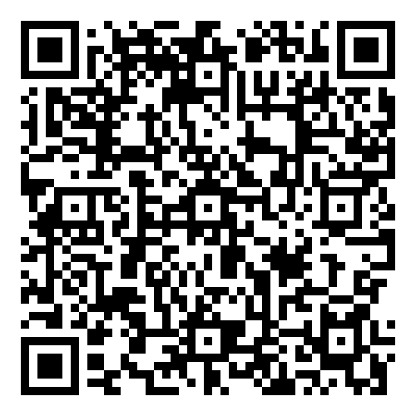


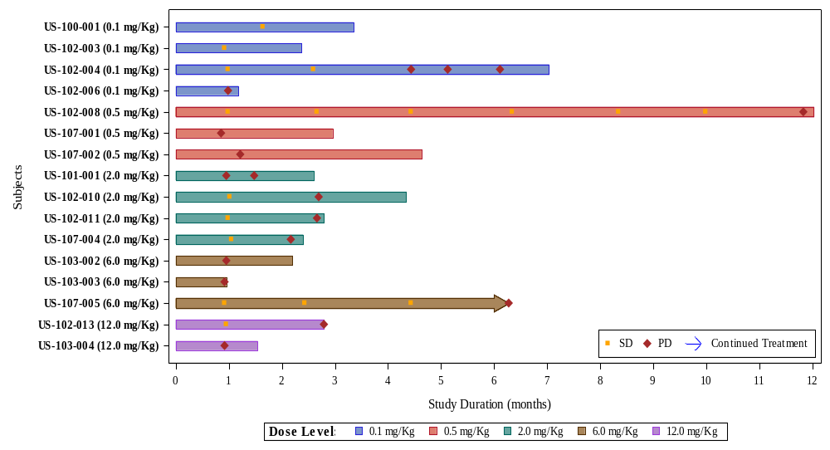
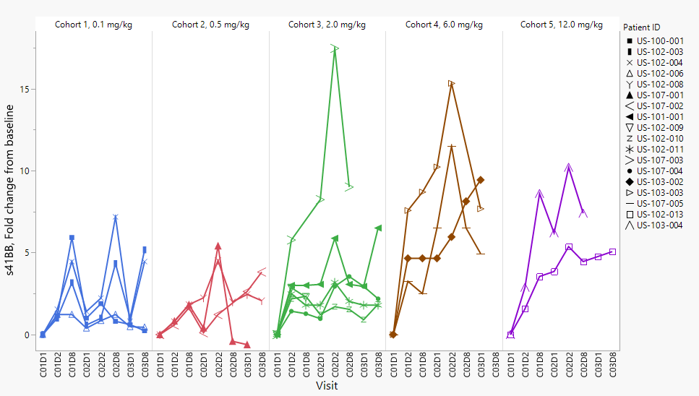
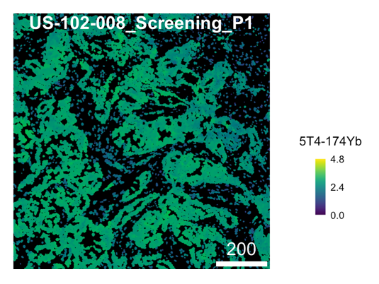

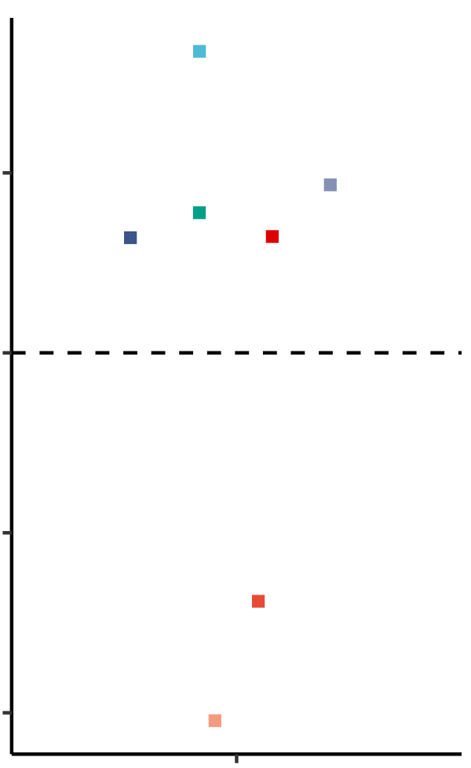
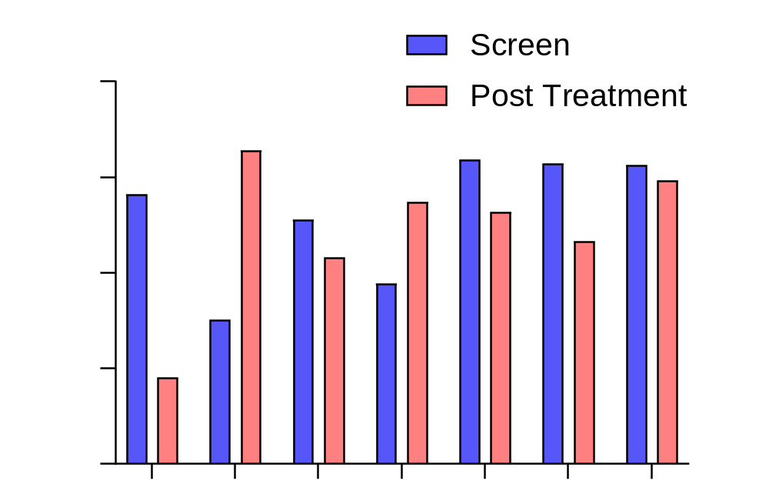
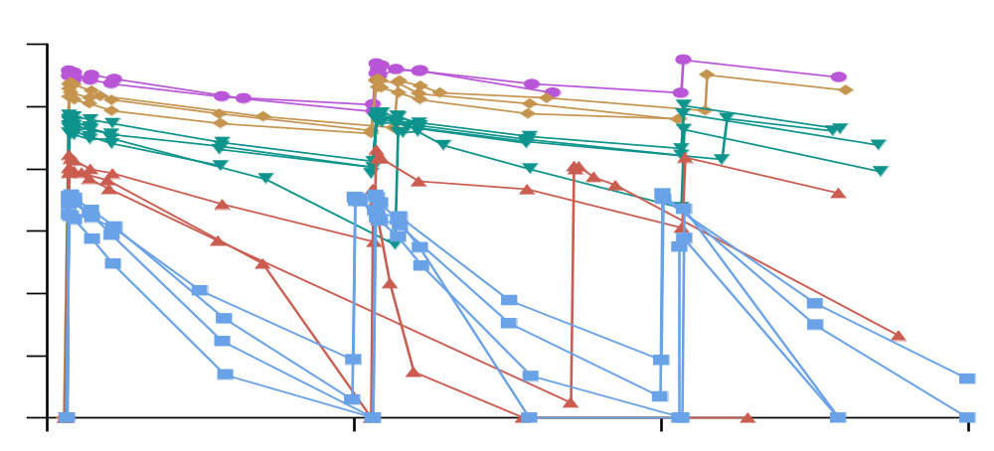
673: Preliminary results from a phase I dose escalation study of ALG.APV-527, a 5T4 x 4-1BB bispecific antibody,
in patients with advanced solid tumors demonstrate favorable safety and biological activity
Thomas Marron¹, Seth Rosen², Douglas Orr³, John Powderly II⁴, Jennifer Segar⁵, Noor Khaskhely⁶, Lynn Bonham⁶, Michelle Nelson⁶, Caroline Taromino⁶,
Daphne Taylor⁶, John Kumer⁶, Ashley Milton⁷, Peter Ellmark^{8,9}, Sara Fritzell⁸, Sumeet Ambarkhane⁸, Dirk Huebner⁶, Asrar Alahmadi¹⁰
1.Tisch Cancer Center, Icahn School of Medicine at Mount Sinai, New York, NY, USA; 2.Hematology Oncology Associates of the Treasure Coast, Port Saint Lucie, FL, USA; 3.Mary Crowley Cancer Research, Dallas, TX, USA; 4.Carolina BioOncology Institute, Huntersville, NC, USA; 5.University of Arizona Comprehensive Cancer Center, Tucson, AZ, USA; 6.Aptevo Therapeutics, Seattle, WA, USA; 7.KHM Pharma Consulting, Massachusetts, USA; 8.Alligator Bioscience AB, Lund, Sweden; 9.Department of Immunotechnology, Lund University, Lund, Sweden; 10.Ohio State University Comprehensive Cancer Center, Columbus, OH, USA
Acknowledgements: We would like to thank Sarah Jones, Likiso Nyambi and Jennifer Price for pharmacology data analysis, Sirona Dx for IMC, Rules Based Medicine s41BB and PPD for PK testing.
About ALG.APV-527
Baseline Characteristics
Duration on Study
Consistently increased soluble 4-1BB in blood following ALG.APV-527 treatment
ALG.APV-527 is a bispecific therapeutic containing binding domains targeting the co-stimulatory receptor 4-1BB and the oncofetal antigen 5T4, expressed on multiple solid tumor types. These are linked to an effector-null Ig Fc domain, providing an antibody-like in vivo half-life
The scFvs originate from the Alligator Gold® human scFv library (Alligator Bioscience) and optimized for use in the bispecific ADAPTIR™ format (Aptevo Therapeutics)
ALG.APV-527 features targeted T cell stimulation, optimized stability, good manufacturing properties with potential for better risk-benefit in humans than monospecific 4-1BB antibodies
Dose (mg/kg) Total n=18 | Median age (range) | Gender (%) |  | ECOG PS (%)
 |  | F | M | 0 | 1
Cohort 1 0.1 (n=4) | 75.5 (71-82) | 2 (50) | 2 (50) | 0 | 4 (100)
Cohort 2 0.5 (n=3) | 58.0 (56-74) | 1 (33) | 2 (67) | 0 | 3 (100)
Cohort 3 2.0 (n=6) | 56.5 (39-72) | 5 (83) | 1 (17) | 2 (33) | 4 (67)
Cohort 4 6.0 (n=3) | 47.0 (44-60) | 2 (67) | 1 (33) | 1 (33) | 2 (67)
Cohort 5 12.0 (n=2) | 56.0 (51-61) | 2 (100) | 0 | 0 | 2 (100)
Prior Anti-Cancer Therapy | n (%); median (range)
Surgery | 8 (44); 1 (1-3)
Radiotherapy | 12 (67); 1 (1-3)
Systemic Therapy | 18 (100); 6 (2-8)
Colorectal Cancer
Colorectal Cancer
15
Cohort 1
0.1 mg/kg
Cohort 2
0.5 mg/kg
Cohort 3
2.0 mg/kg
Cohort 4
6.0 mg/kg
Cohort 5
12.0 mg/kg
Anti-4-1BB scFv
GE Junction (Esophageal)
Breast Cancer *
10
Soluble 4-1BB
Fold Induction from Baseline
Pancreatic Cancer *
Breast Cancer
5
Modified
Fc
Prior Systemic Therapy | n (%)
Chemotherapy & other antineoplastic therapies | 18 (100)
Immune and antibody therapies* | 13 (72)
Pancreatic Cancer *
Pancreatic Cancer *
Colorectal Cancer *
Dose Level (mg/kg)
0.1 0.5
2.0 6.0
12.0
0
C01D1
C01D2
C01D8
C02D1
C02D2
C02D8
C03D1
C01D1
C01D2
C01D8
C02D1
C02D2
C02D8
C03D8
C03D1
C01D1
C01D8
C03D8
C02D1
C02D2
C02D8
C01D2
C03D1
C03D8
C01D1
C01D2
C01D8
C02D1
C02D2
C02D8
C03D1
C03D8
C01D1
C01D2
C01D8
C02D1
C02D2
C02D8
C03D1
Anti-5T4 scFv
Colorectal Cancer
Visit (Cycle1-3 Day1,2 or 8)
C03D8
Cutaneous SCC
Serum soluble 4-1BB increases with dosing, generally peaking at days 2-8 following ALG.APV-527 treatment. Samples were evaluated using Luminex technology and graphically represented as fold change from baseline. Data cutoff 12Sept2024.
Published preclinical studies demonstrate the design and mechanism of action of ALG.APV-527 are ideal for clinical study.
Mol Cancer Ther. 2023 Jan 3;22(1):89-101. doi: 10.1158/1535-7163.
n= number of patients; *bevacizumab (8), pembrolizumab (3), nivolumab (2), ipilimumab, IL-2, cetuximab, panitumumab, durvalumab, cemiplimab
NSCLC
Colon Cancer
Treatment-Related AEs
Renal CC
Colon Cancer
5T4 expressed across various tumor types making it an ideal tumor-associated antigen
ALG.APV-527 Mode of Action
>1 Patient 18 total patients | n (%) E
Any TRAE | 16 (89) 92
Fatigue | 4 (22) 6
Infusion-related reaction | 4 (22) 7
Diarrhea | 3 (17) 4
Pruritus | 3 (17) 4
Nausea | 2 (11) 2
ALT increase | 2 (11) 2
Anemia | 2 (11) 4
Neutrophil count dec. | 2 (11) 2
WBC count decrease | 2 (11) 3
Myalgia | 2 (11) 2
Dyspnea | 2 (11) 3
Serious Treatment-Related AEs | n (%) E
Any Serious TRAE | 4 (22) 5
Febrile neutropenia* | 1 (6) 1
Ulcerative colitis | 1 (6) 1
Hemorrhagic diarrhea | 1 (6) 1
GI hemorrhage | 1 (6) 1
Nausea | 1 (6) 1
NSCLC
SD
PD
Continued Treatment
0
1
2
3
4
5
6
7
8
9
10
11
12
Cancer type | 5T4 (intensity*)
Colon Cancer | Positive (144)
Breast Cancer | Positive (109)
Esophageal Cancer | Positive (100)
Breast Cancer | Positive (182)
Pancreatic Cancer | Positive (203)
Pancreatic Cancer | Positive (231)
Colon Cancer | Positive (213)
Colorectal Cancer | Positive (211)
Colon Cancer | Positive (223)
Cutaneous SCC | Positive (266)
Colon Cancer | Positive (137)
NSCLC | Positive (234)
NSCLC | Positive (204)
Renal Cell | Positive (230)
ALG.APV-527
Study Duration (Months)
5T4 antigen
Fifteen of 16 patients were evaluable at data cutoff (12Sept2024). Based on RECIST and iRECIST, nine patients had a best overall response of SD. Cohort 2’s breast cancer patient increased dosing from 0.5 to 2.0, then to 6.0 mg/kg after long-term SD.
SD= stable disease, PD= progressive disease *Patients were allowed to stay on study with PD events if agreed upon with the treating physician
4-1BB
Upregulation
TCR/CD3
Overall, ALG.APV-527 was safe and well tolerated. No severe signs of liver toxicity were seen to date.
*Case of Gr4 febrile neutropenia, classified as a DLT, and resolved following Filgrastim treatment. n= number of patients, E= number of events
ALG.APV-527 treatment results in an increased number of CD8 T cells and Ki67-expressing tumor cells in the TME
Fourteen patients had evaluable pretreatment tumor biopsies that were evaluated for 5T4 expression by IMC. All enrolled tumor types were positive for 5T4 expression.
*5T4 scoring was conducted utilizing the modified histoscore, providing a semiquantitative assessment of both staining intensity and the percentage of positive cells.
Increased number and potency of tumor-specific cytotoxic T cells
A
B
ALG.APV-527 directs the stimulation of CD8⁺ T and NK cells by 5T4⁺ tumors and is designed to minimize the toxicity observed with other 4-1BB therapeutics
Dose (mg/kg); Cancer Type
10000
ALG.APV-527 has a favorable PK profile
3
Colorectal Cancer
1000
Study Design
1000
0.1
Breast Cancer
100
Summary and Conclusions
Dose
(mg/kg)
0.1
0.5
2.0
6.0
12.0
Absolute Number of Ki67-expressing
tumor cells per mm² tissue area
The Phase I study is a first-in-human, open-label, multicenter trial consisting of up to six cohorts (0.1-15 mg/kg) with a 3+3 dose escalation of ALG.APV-527 monotherapy, administered IV Q2W, in adult patients with advanced solid tumors. Eligibility is limited to patients with tumor types identified as likely to express 5T4 antigen.
Clinical Trials Number: NCT05934539
100
0
Esophageal Cancer
10
ALG.APV-527 continues to demonstrates good tolerability, safety, and biological activity. No serious liver toxicity has been demonstrated with this conditional 4-1BB bispecific due to its design. Serum concentrations of ALG.APV-527 were consistent with the administered dose. Nine of 16 evaluable patients (56%) had a best overall response of SD, with the longest SD duration in a breast cancer patient >11 months. One colon cancer patient with sustained SD remains on study. Increases in serum soluble 4-1BB and intratumoral CD8 T cells have resulted after ALG.APV-527 dosing. Dose escalation is ongoing. An MTD has yet to be determined.
10
Log2 Fold Increase: CD8 T cells
per mm² tissue area
0.5
Breast Cancer
Conc. µg/mL
Colorectal Cancer
1
1
-3
2.0
Cutaneous SCC
Breast Cancer
Breast Cancer
NSCLC
0.1
Esophageal Cancer
Cutaneous SCC
6.0
NSCLC
Colorectal Cancer
Colorectal Cancer
Key Objectives
Characterize safety & tolerability profile of ALG.APV-527
Identify MTD and/or RP2D
Characterize PK profile after single and repeated IV administration
Assess potential immunogenicity effects
Obtain a preliminary assessment of anti-tumor activity
0.01
12.0
Renal CC
0.1
0.5
2.0
6.0
0.001
-6
Dose (mg/kg); Cancer Type
0
14
Study day
*
28
42
-5
ALG.APV-527 displays a favorable PK profile; the drug is detectable in the serum of all patients tested thus far and exposure is similar to the human PK prediction from NHP studies. Data displayed through cycle 3.
*One Cohort 2 patient C2D1 dose delayed 10 days to study day 24
Note: updating graph soon with larger dots/coloring; confirm NSCLC pt. in CD8 graph; confirm Renal pt in ki67
Using imaging mass cytometry (IMC), eight patients had evaluable pre- and posttreatment tumor biopsies (Cycle 3/Day 1 (+2 days)). The number of intratumoral CD8 T cells (A) and Ki67-expressing tumor cells (B) that changed compared between pre and post treatment are graphically represented. Data cutoff 12Sept2024

